Slide 1
Introduction to Web & HTML

Slide 2
Topics
Web Terminology
HTML
  What is HTML
  Parts of an HTML Document
  HTML Tags
    Required
    Common

Slide 3
Internet vs. WWW
Most people use the two terms interchangeably but they are in fact different.
The Internet is a vast, international network, made up of computers and the physical connections (wires, routers, etc.) allowing them to communicate.
The World Wide Web (WWW or just the Web) is a collection of software that spans the Internet and enables the interlinking of documents and resources.
  Provides a way of accessing information on the Internet.
For more information about the history of the Internet and WWW:
http://en.wikipedia.org/wiki/Internet

Slide 4
Web Servers and Clients
A Web server is a computer that is programmed to send files to browsers on other computers connected to the Internet.
The Web browser, such as Firefox or Internet Explorer, is the client that sends a request for a Web page.
The Web server answers the request and delivers the requested page to the browser so you can view it.

Slide 5
HTTP
Stands for HyperText Transfer Protocol
Allows computers on the WWW to communicate with one another.
Handles the “request” sent to the Web server and the “response” received from the Web server.

Slide 6
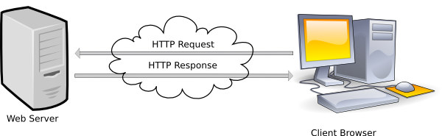
Web Server-Client Diagram

Slide 7
URLs
Stands for Uniform Resource Locator
Also called the Web page’s address
You typically type it into your Web browser’s location bar when you want to view a Web page
http://www.umbc.edu
Protocol needed to communicate with Web server
Name of Web server

Slide 8
HTML
Stands for HyperText Markup Language
Used to create a Web page
Made up of tags that specify the structure of the document (this section is a heading, this section is a paragraph, etc..)
An excerpt from a sample HTML document:
<html>
<head>
<title>Bob’s Web page</title>
</head>
<body>
<h1>This is my first Web page</h1>

Slide 9
HTML Tags
Most HTML tags work in pairs. There is an opening and a closing tag. For example:
<p>Some content here.</p>
The <p>…</p> tag displays a paragraph
<p> opens the paragraph (opening tag)
</p> closes the paragraph (closing tag)
“Some content here.” will be displayed on the page

Slide 10
Self-closing Tags
Some HTML tags are self closing. For example:
<br />
The <br /> tag will display a line break.

Slide 11
Required Tags
All HTML documents should have html, head and body tags, along with the DOCTYPE identifier.
  !DOCTYPE – Tells the browser which set of standards the page adheres to
  <html>…</html> -- Surrounds the contents of the entire page
  <head>…</head> -- Lists the identification information on the page, such as the title
  <title>…</title> -- Gives the name of the page that appears in the top of the browser window
  <body>…</body> -- Frames the content of the page to be displayed in the browser

Slide 12
Basic HTML Template
<!DOCTYPE html>
<html>
<head>
<title>CMSC104 HTML Template</title>
</head>
<body>
This is just a basic HTML template to be used in CMSC104.
</body>
</html>
Example file: template.html

Slide 13
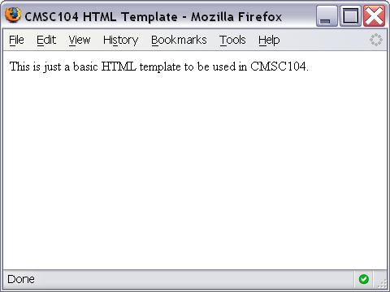
Basic HTML Template Screenshot

Slide 14
Some Common HTML Tags and Their Meanings
<p>…</p> -- Creates a paragraph
<br /> -- Adds a line break
<hr /> -- Separates sections with a horizontal rule
<h1>…</h1> -- Displays a heading (h1-h6)
<!--…--> -- Inserts a comment
<ol>…</ol> -- Creates an ordered list
<ul>…</ul> -- Creates an unordered list
<img /> -- Inserts an image into the document
<a>…</a> -- Inserts a link into the document

Slide 15
Paragraph Example
<p>
The exam next week will consist of T/F, multiple choice, short answer and pseudocode questions. You cannot use a calculator.
</p>
<p>
After the exam, we will learn JavaScript. It should be fun!!
</p>

Slide 16
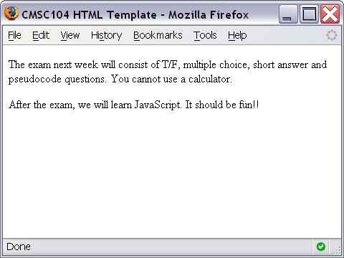
Paragraph Example Screenshot

Slide 17
Line Break Example
<p>
Roses are Red. <br />
Violets are Blue. <br />
You should study for Exam 1. <br />
It will be good for you!
</p>

Slide 18
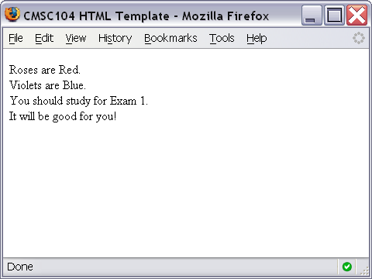
Line Break Example Screenshot

Slide 19
Horizontal Rule Example
<p>
The exam next week will consist of T/F, multiple choice, short answer and pseudocode questions. You cannot use a calculator.
</p>
<hr />
<p>
After the exam, we will learn JavaScript. It should be fun!!
</p>

Slide 20
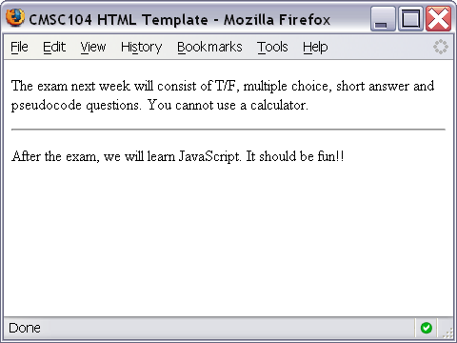
Horizontal Rule Example Screenshot

Slide 21
Heading Example
<h1>This is heading 1</h1>
<h2>This is heading 2</h2>
<h3>This is heading 3</h3>
<h4>This is heading 4</h4>
<h5>This is heading 5</h5>
<h6>This is heading 6</h6>

Slide 22
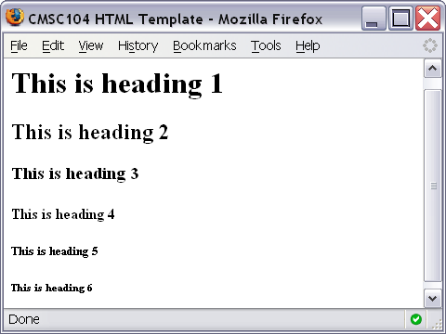
Heading Example Screenshot

Slide 23
Comment Example
<!-- This is just some sample html to illustrate the use of a comment -->
<p>
Here is my paragraph.
</p>
<!-- Here is another comment -->

Slide 24
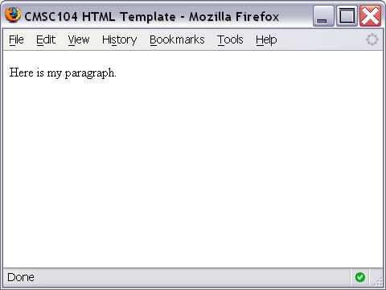
Heading Example Screenshot

Slide 25
Ordered List Example
<ol>
<li>Print Review Questions for Exam 1.</li>
<li>Work on Review Questions for Exam 1.</li>
</ol>

Slide 26
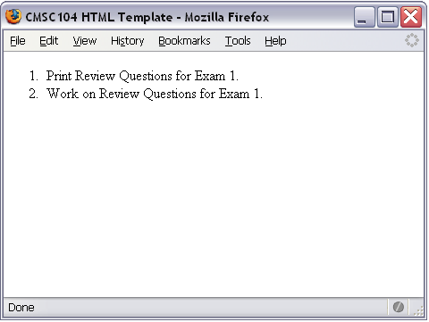
Ordered List Screenshot

Slide 27
Unordered List Example
<ul>
<li>country music</li>
<li>monday mornings</li>
<li>brussels sprouts</li>
</ul>

Slide 28
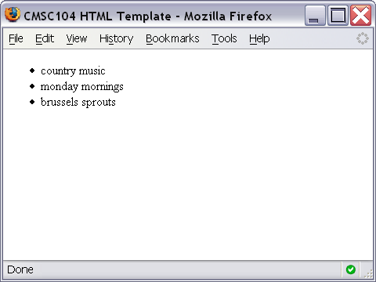
Unordered List Screenshot

Slide 29
Link Example
<a href="http://www.cs.umbc.edu/104/">CMSC104 Main page</a>

Slide 30
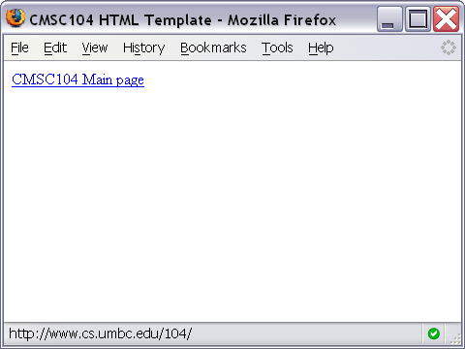
Link Screenshot

Slide 31
Image Example
<img src="linux-tux.png" alt="Tux the Penguin" />

Slide 32
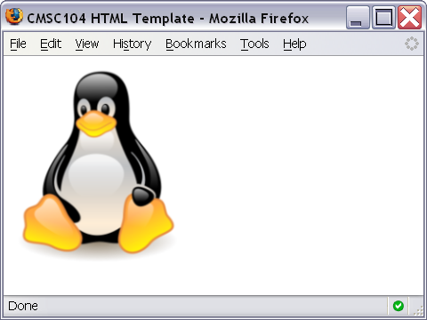
Image Screenshot

Slide 33
Working Example
To see an example page that uses all of the tags we discussed today, visit
http://userpages.umbc.edu/~dblock/lecture6.html

